Slide 1
Resume Classification

Slide 2
Resume classification
Group members :
1. Mr. Akshay Sagar K R
2.Mr.Suhas s
3. Akula Nikhitha
4.Mr .Anumalasetty Bhargav Narayana
5.Mr Bharathi kannan.S
6.Rajesh Gandla

Slide 3
Business Objective
The document classification solution should significantly reduce the manual human effort in the HRM. It should achieve a higher level of accuracy and automation with minimal human intervention

Slide 4
Project work Flow
Converting files to dataframe ,Filtering data like stop words, special symbols, URLs, numbers and punctuations, lemmatization, single characters, unwanted symbols.
EDA
Feature extraction
Using techniques like vectorization, count vectorizer, TFIDF
Model building
Using techniques like Random Forest, Decision tree, Logistic Regression, SVM, naive bayers classifier, XGBoosting, Stacking, Voting
model deployment
Using Streamlit

Slide 5
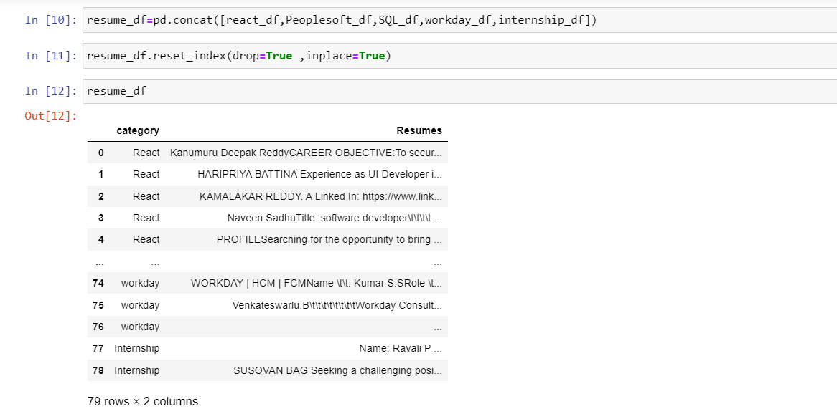
eda
Extracting Data from Resumes
Converting all files into data frame
Pre-processing data

Slide 6
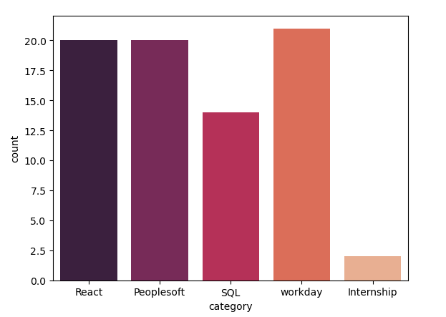
Dataset details
there are total of 78 resume files
They are categorized into types:
1.Peoplesoft
2.React
3.Workday
4.SQL
5.internship

Slide 7
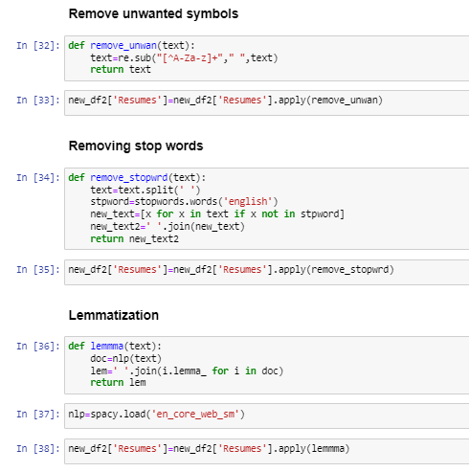

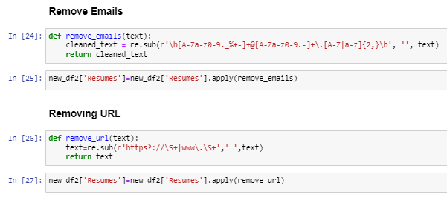
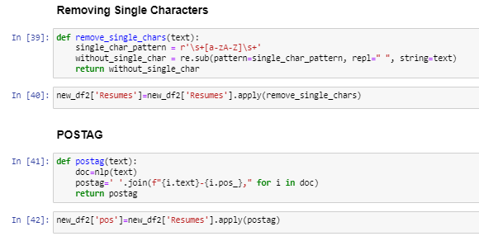
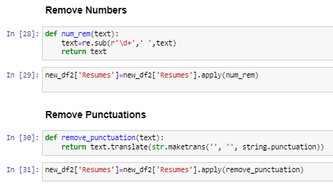
Data modification
1.lowering
2.removing special symbols URLs, emails
5.removing post tags and single letters

Slide 8
Feature extraction
Feature extraction is done with 2 methods
Count vectorization
TFIDF
Using this techniques we can create 3 types of data each:
1.Unigram
2.Bigram
3.Combination of unigram and bigram.
**then we will have 6 datasets

Slide 9

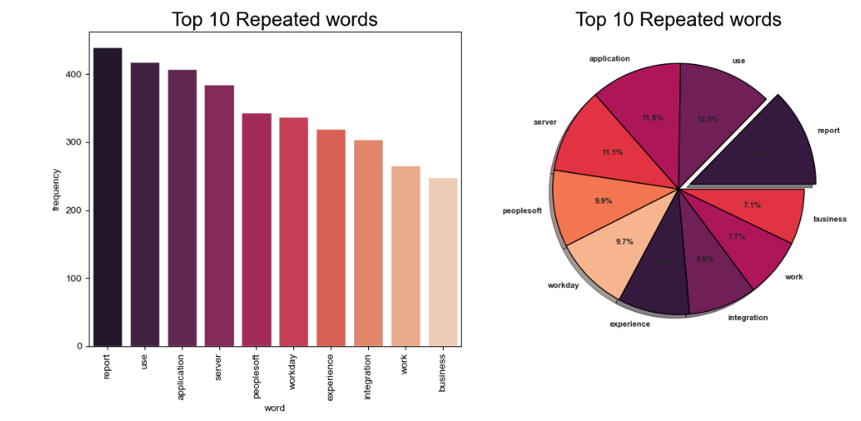
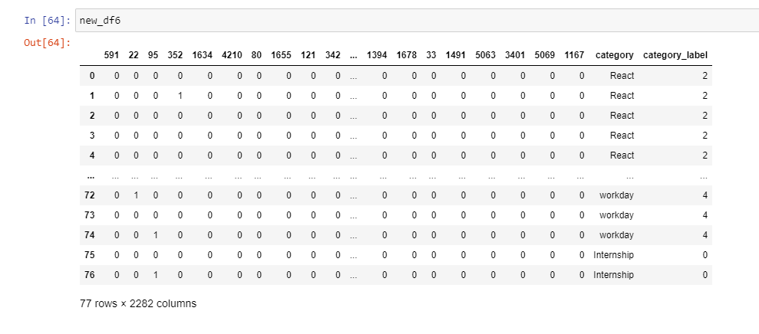
Countvectorization: unigram data
Observation: here in countvectorization:unigram the most repeated word is “report”.

Slide 10

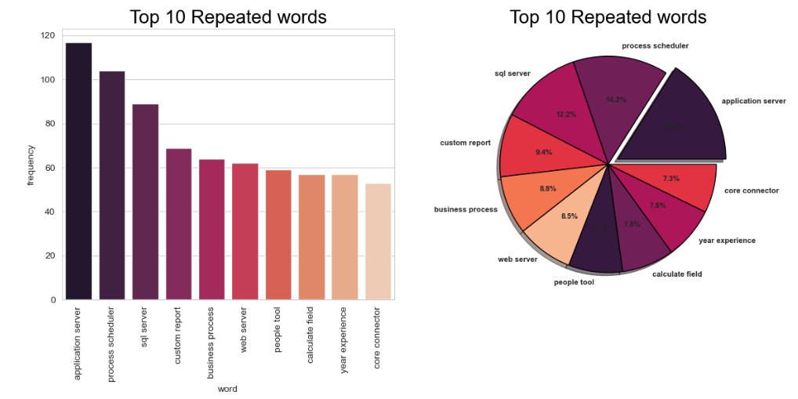
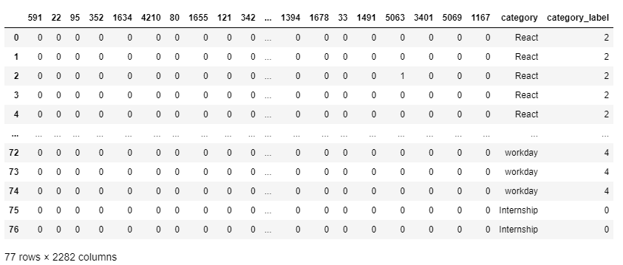
Countvectorization: bigram data
Observation: here in countvectorization:bigram the most repeated word is “application server”.

Slide 11

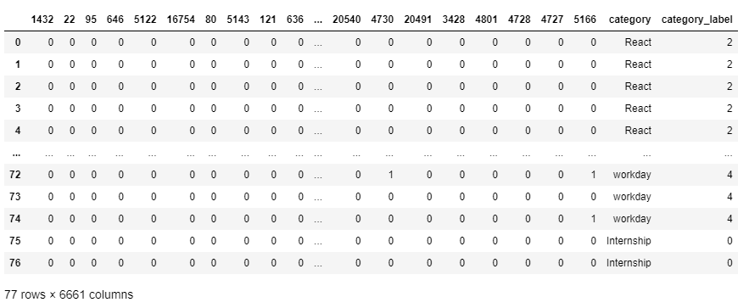
Countvectorization: unigram and bigram
Observation: here in countvectorization: unigram and bigram the most repeated word is “report”.

Slide 12

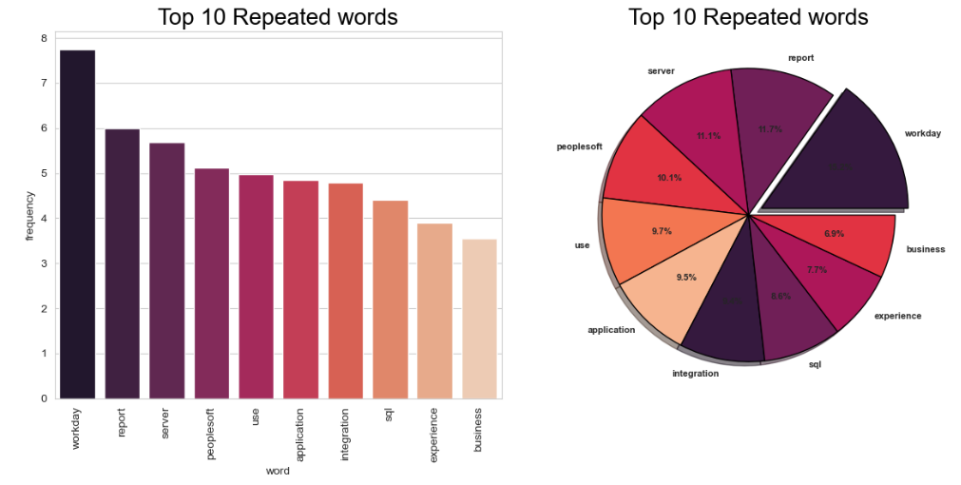
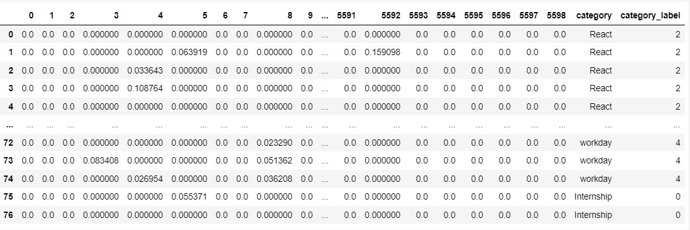
Tfidf:unigram
Observation: here in TFIDF:unigram the most repeated word is “workday”

Slide 13
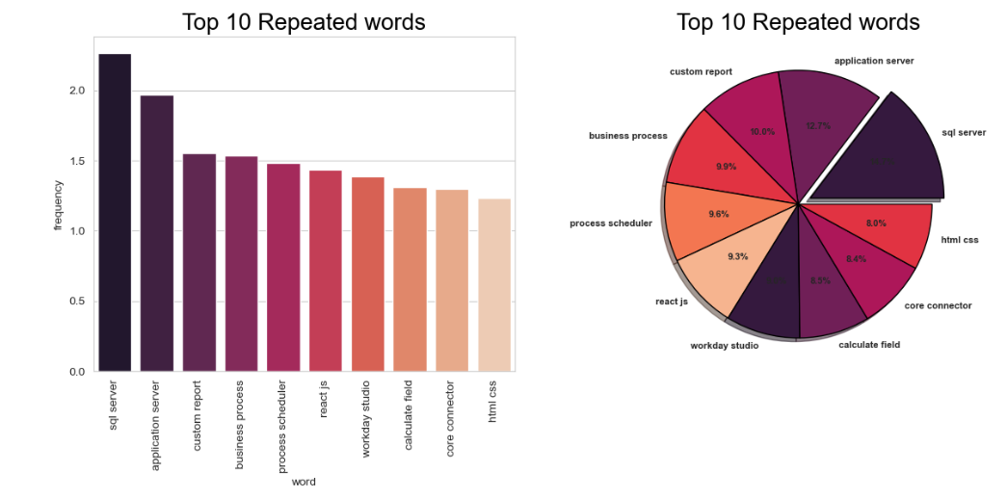
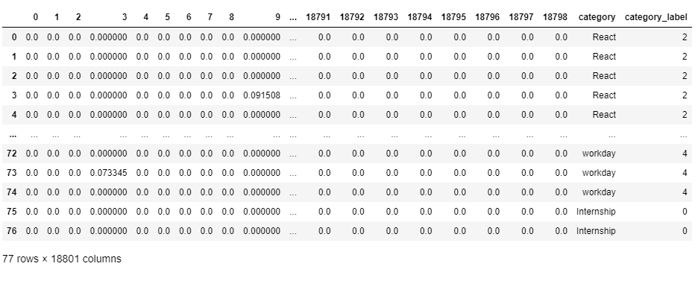
Tfidf:bigram
Observation: here in TFIDF:BIGRAM the most repeated word is “Sql server”

Slide 14
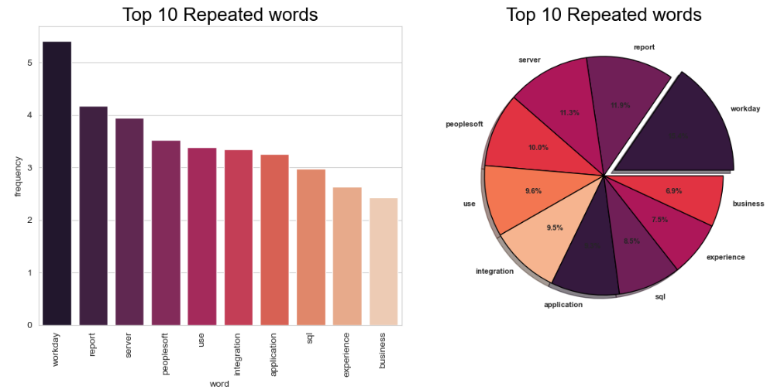
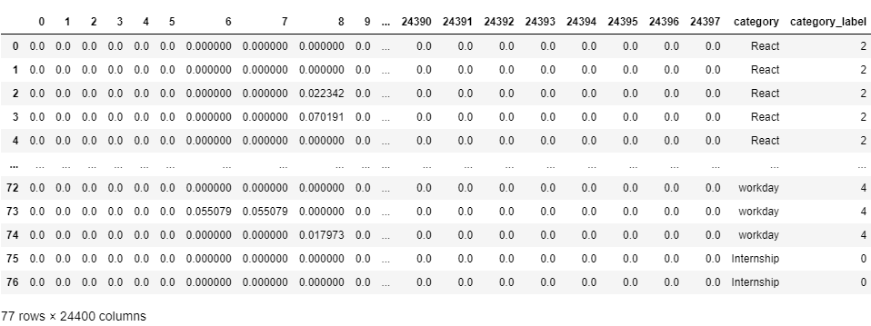
Tfidf: unigram and bigram
Observation: here in TFIDF:UNIGRAM AND BIGRAM the most repeated word is “workday”

Slide 15
Algorithms Used
1.Random Forest
2. Decision tree
3. Logistic Regression
4. SVM
5. naive bayers classifier
6. XGBoost
7. Stacking
8.Voting

Slide 16
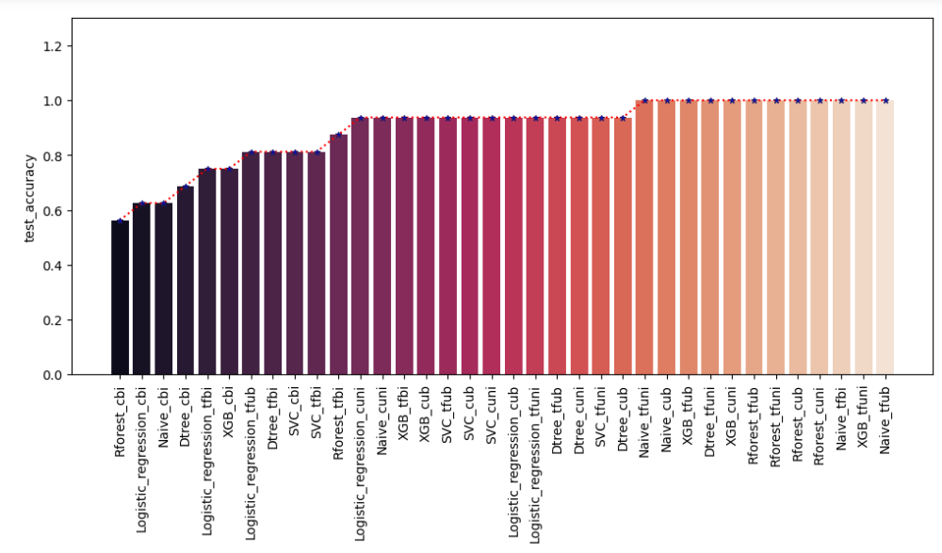
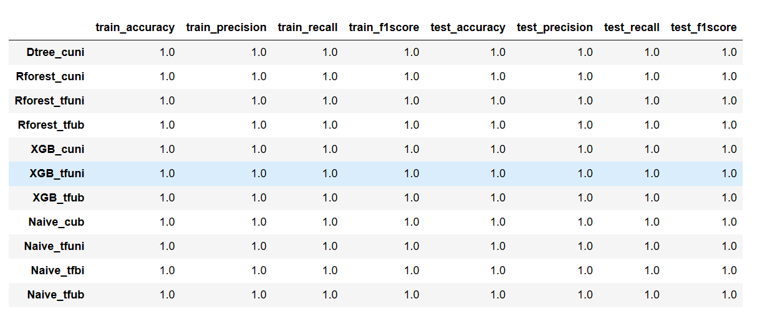
Testing Accuracy
Observation:TFIDF with Unigram and Uni-Bi gram is having high training and testing accuracy with models Randomforest,XGBoost and Naive Bayers classifier ,So we can go for a Stacking or Voting Classifier with these models

Slide 17
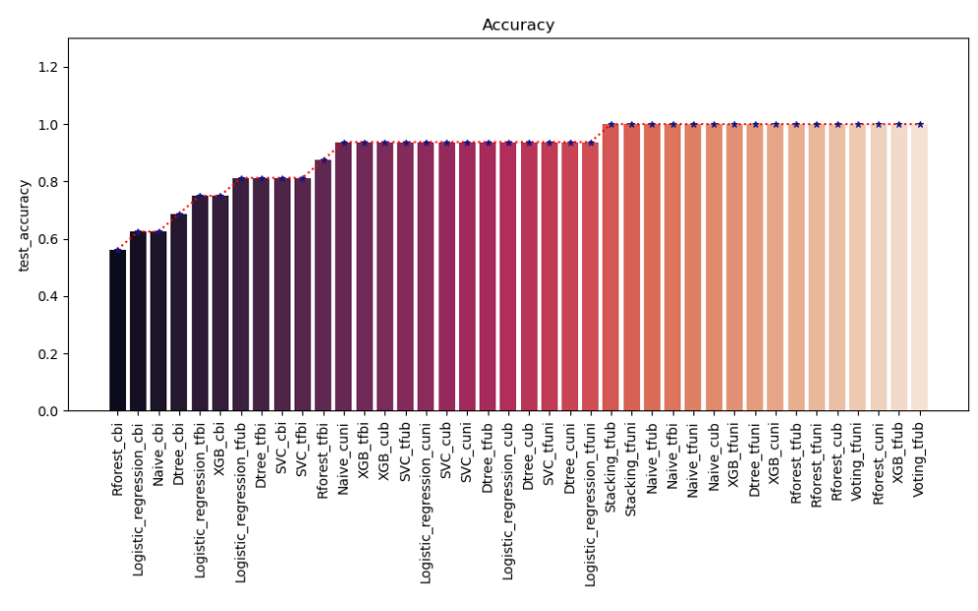
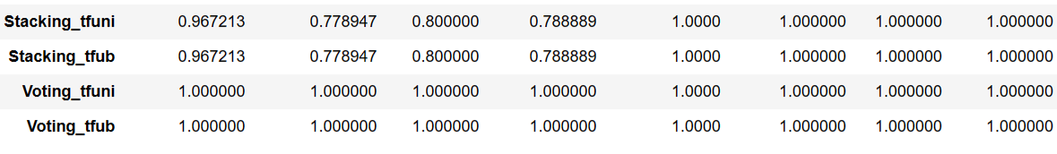
Testing Accuracy
Observation:TFIDF with Unigram and Uni-Bi gram is having high training and testing accuracy

Slide 18
final MODEL
Model:Voting classifier with models Random forest ,Xgboost and Multinomial NB
Vectorization:Tfidf with Uni-bi gram

Slide 19
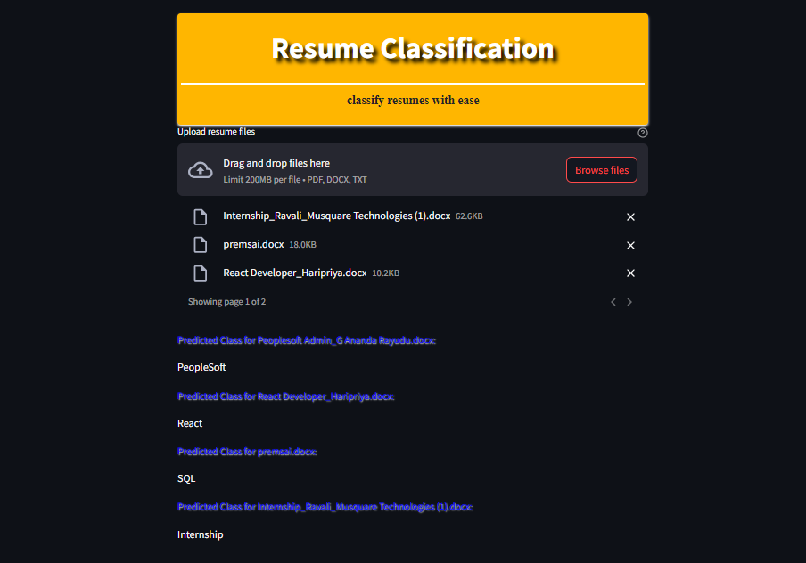
deployment
Deployment is done using streamlit

Slide 20
ThANK YOU

